Slide 1
Fiscal Year 2021
MUSG - Operating Budget Process
MARQUETTE UNIVERSITY

Slide 2
Operating Budget
University Budget
  What is a budget and why implement?
    A map in financial terms that allows the university to carry out it’s mission
    It is a form of resource allocation which is in line with the university’s planning and assessment
    Planning determines what needs to be done and budgeting allocates the resources to support the plan
      Operating
      Capital
    A budget is not the plan but is the product of the university’s planning process
    A controlling process

Slide 3
Sources of Funding
Unrestricted Funds
  Funds acquired through annual operations
    Tuition and Fees
    Room and Board
    Auxiliary Income
    Sales and Service
    Investment Income
Restricted Funds
  Donor restricts the organization to allocate their restricted funds to a specific purpose:
    Capital Project
    Scholarships
    Initiative(s)
Other
  Debt
  Grants

Slide 4
Budget Building Assumptions
Recruitment of an incoming class
  Financial Aid
Beyond Boundaries
  Strategic Initiatives
    Enrollment
      International
      Hispanic Serving Institution
    Graduate programs (incubator / revenue share)
    Online Courses
    External Partnerships
Fringe Benefits
  Healthcare
Merit Pool
Non-Discretionary Expenses
  Utilities
  Interest
  Contract Maintenance

Slide 5
FY21 Operating Budget Summary
  FY21 Balanced Budget
    Revenues $468 million
    Expenses $468 million

Slide 6
FY21 Operating Budget – Summary (cont’d)
  Manage Challenges:
  Enrollment – main driver of university revenues
  Affordability of higher education
    Reduced trend in tuition increases
    Increased scholarship aid
  Cost increases – inflationary and compensation
  Cost Control:
  Staff Headcount Management
  Operating Efficiencies
  Space Optimization
  “Think Different” Ideation Process
  Growth:
  Continue to invest in key growth initiatives (online, graduate growth, etc.)

Slide 7
Operational Efficiencies – A Proactive Approach
Objectives – A future of financial stability
Operate more efficiently to help keep education affordable for students and families
Address inefficient and ineffective processes to utilize resources more effectively in support of the University’s mission and Beyond Boundaries strategic plan.
Process – guided by data and collaborative input
Process is a continuation of the activities that occurred last fall with Deans, Vice Presidents, and Vice Provosts, sharing ideas of operational efficiencies.
Planning Phase – sharing data and gathering input – down to each unit on campus
Execution Phase – execute and sustain
Other Campus Community participation
People – a campus-wide effort
Targeting $3-4M of savings from operational efficiencies

Slide 8
Operating / Capital Budget Investments
Operational
Online Course Development
Graduate Program Development
PA & OT Expansion
Electronic Serials
Capital
The Commons
Improved Green Spaces (Eckstein Common, Henke Terrace, etc.)
707 Hub
Campus Security / Safety
Classroom & Instructional Space Improvements
Books & Periodicals
Annual Housing Improvements
Informational Technology Renewal
Recreational Equipment
Wireless Infrastructure
Checkmarq Enhancements

Slide 9
Five Year Financial Aid Trend

Slide 10
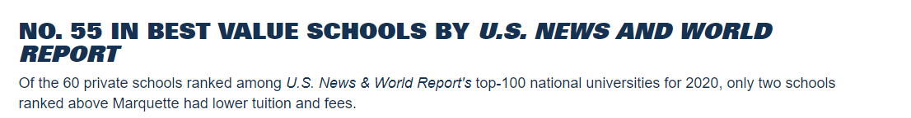
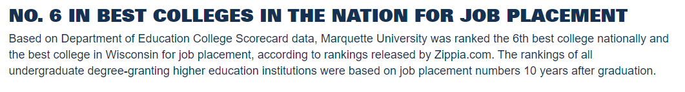
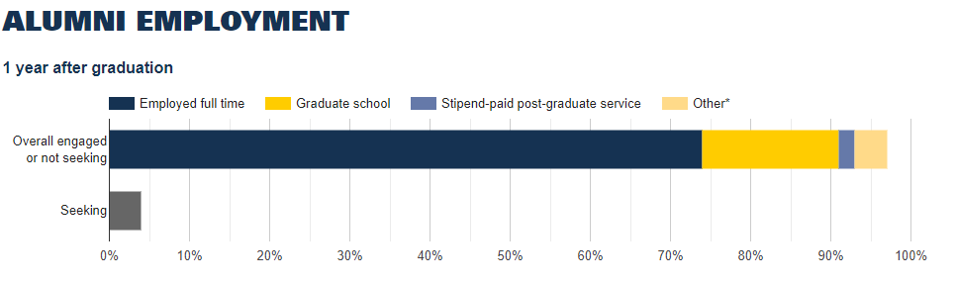
The Value of a Marquette Education
Data applies to undergraduate programs
Notes:
Marquette.edu/value

Slide 11
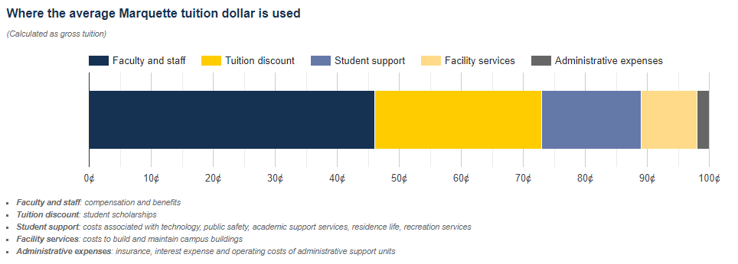
Where the Average Marquette Tuition Dollar is Used
Faculty and staff
Scholarships
Student
Support
Facilities
Admin

